Slide 1
Hospital management system
Dev_Team_2
Aravind vudatha
Lakshmi Priya Mutyala
Vamsi gone
Gopi Mandapati

Slide 2
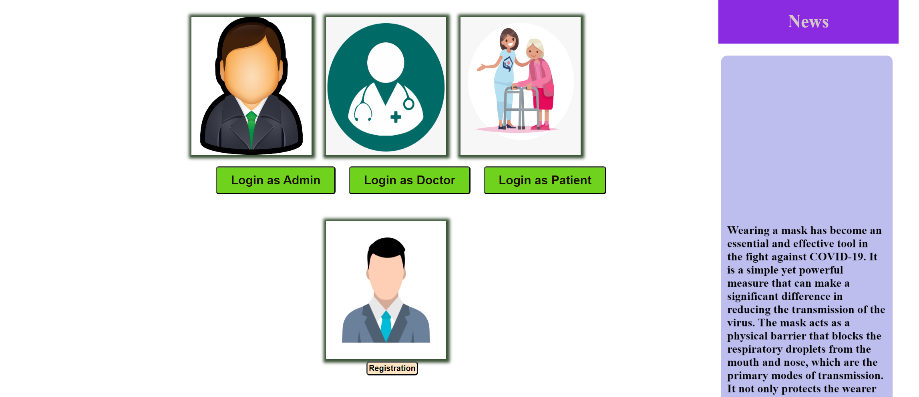
Home page

Slide 3
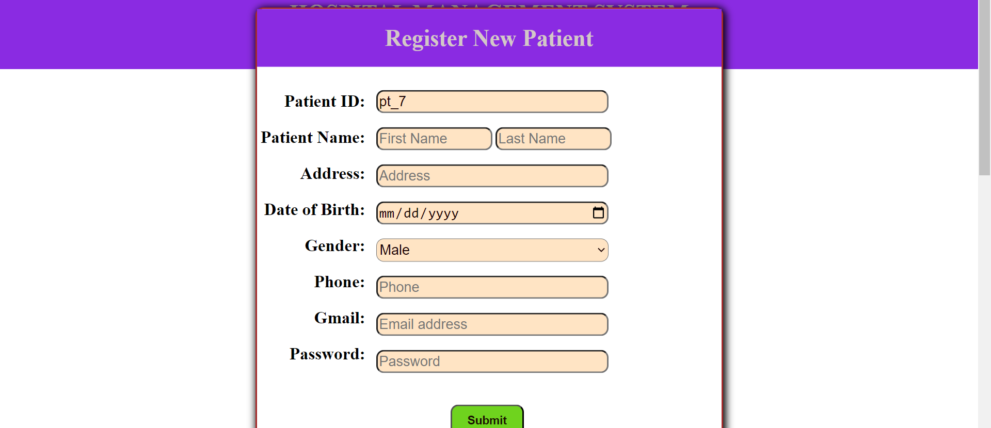
Registration page

Slide 4
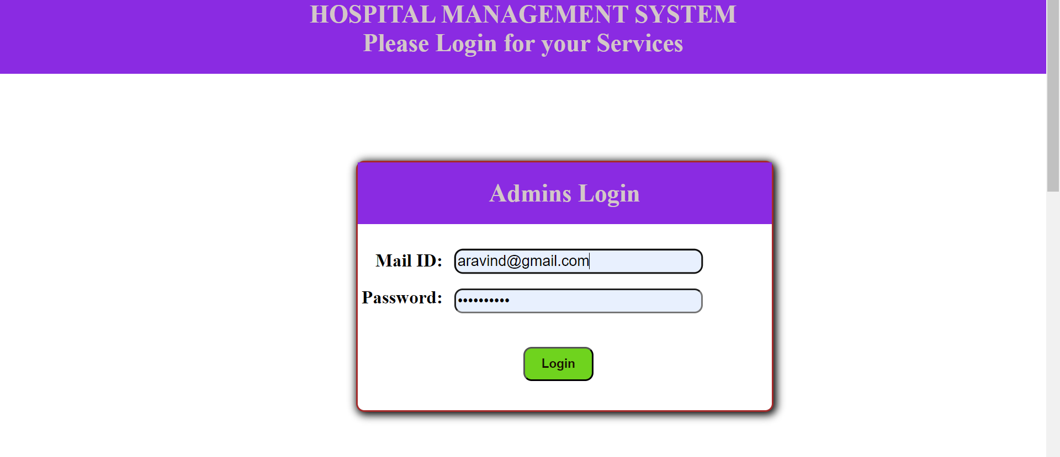
Admins login page

Slide 5
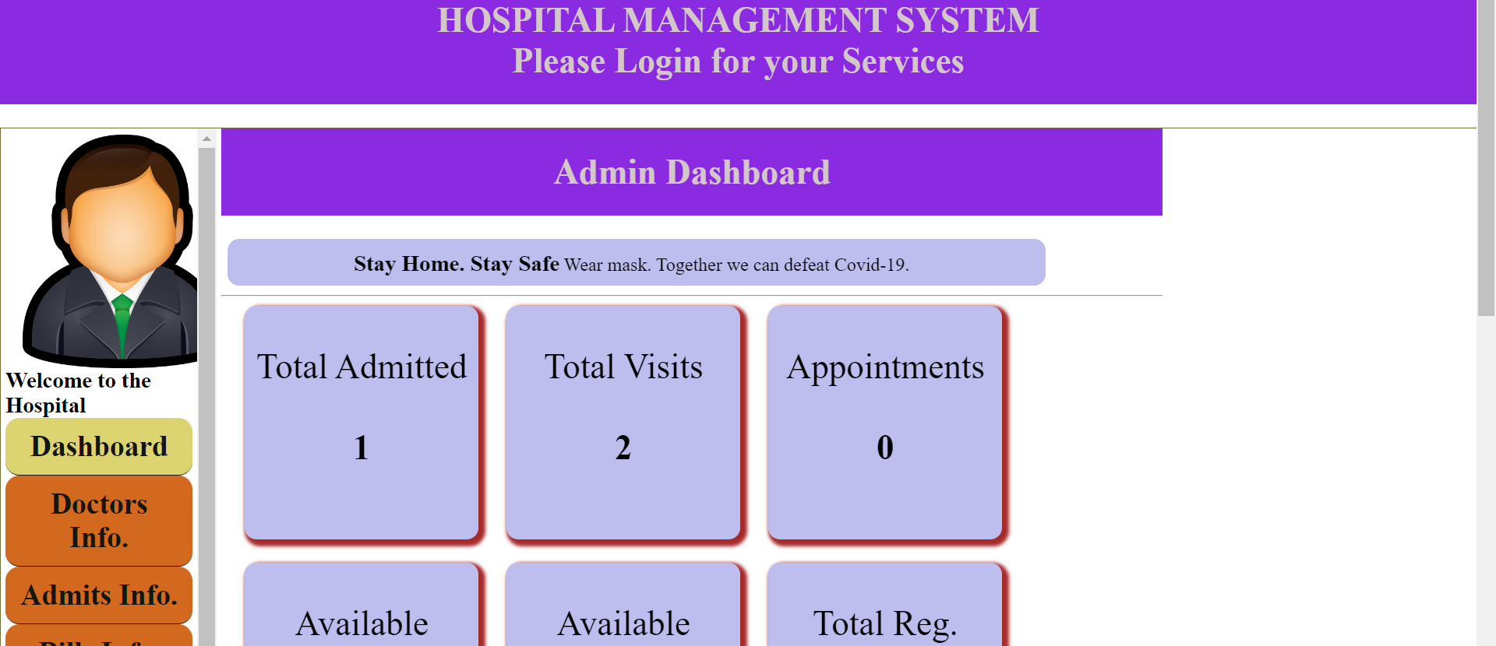
Admin Dashboard

Slide 6
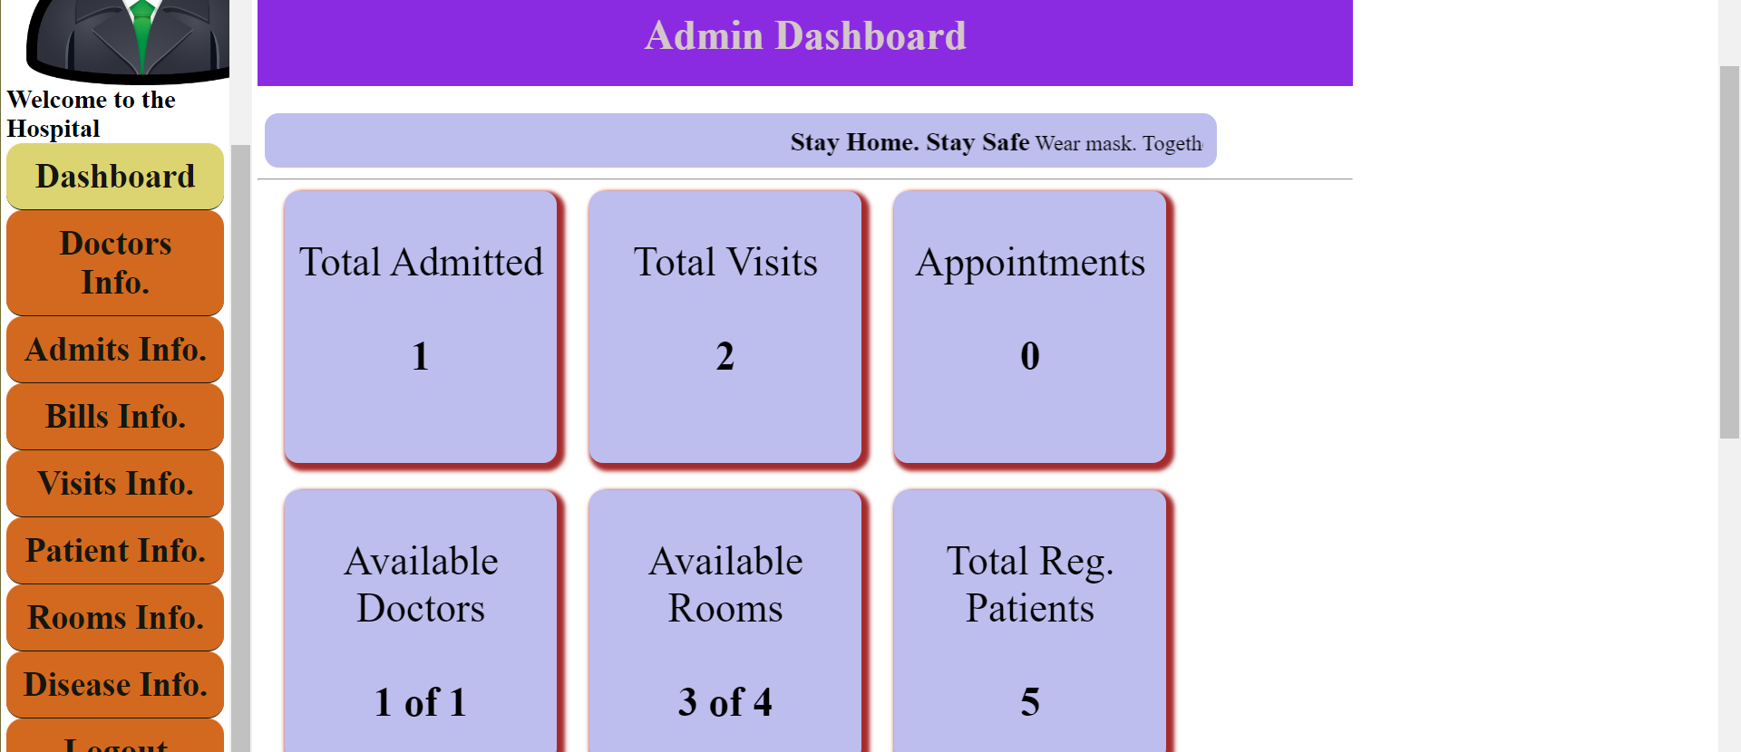
Admin Dashboard

Slide 7
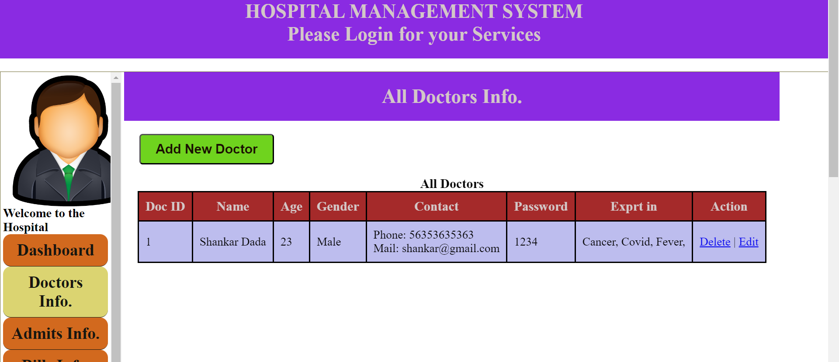
Doctors info in admin portal

Slide 8
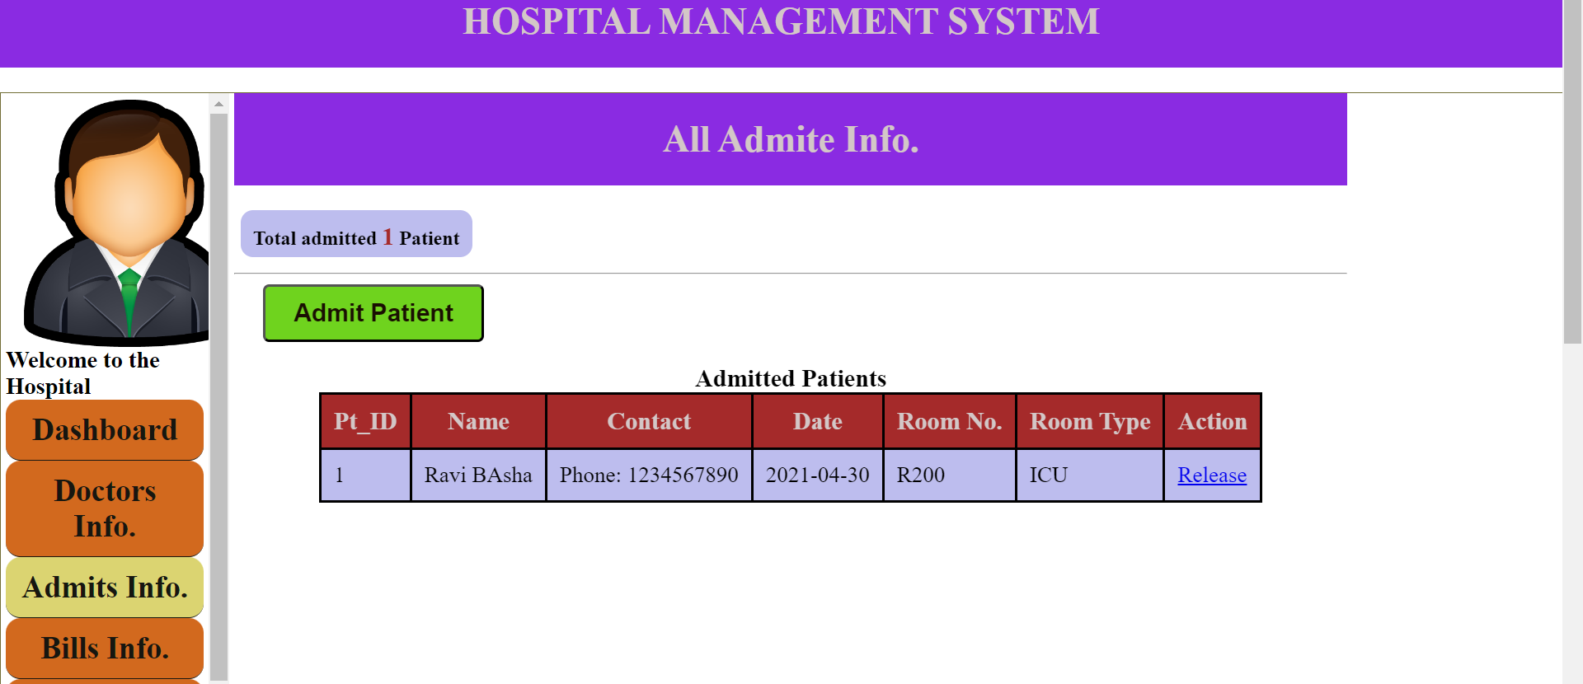
Admits info in admit portal

Slide 9
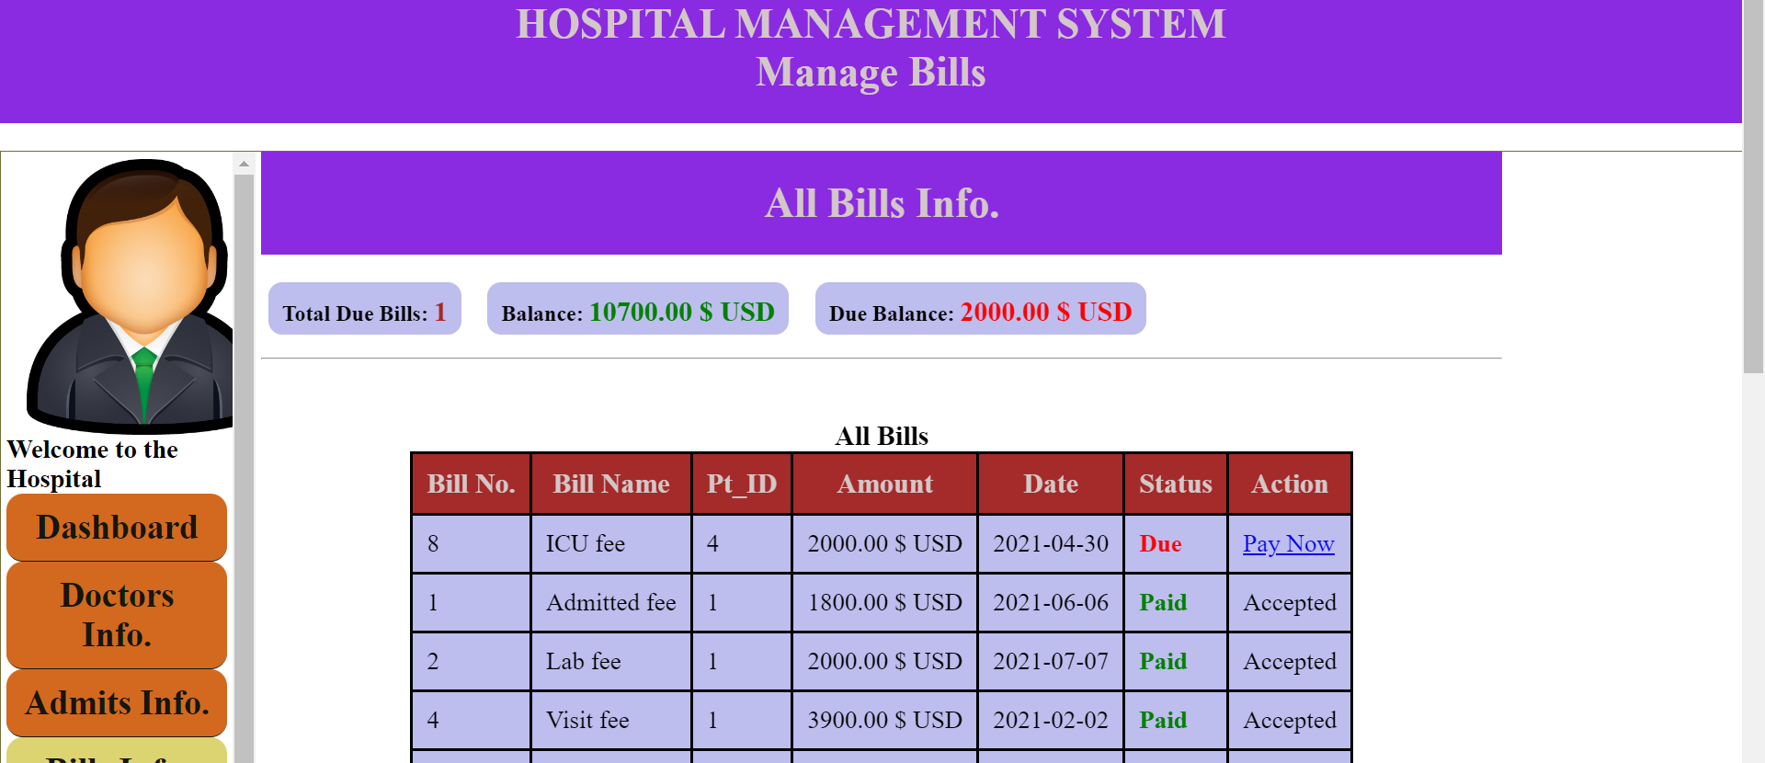
Bills info in admin portal

Slide 10
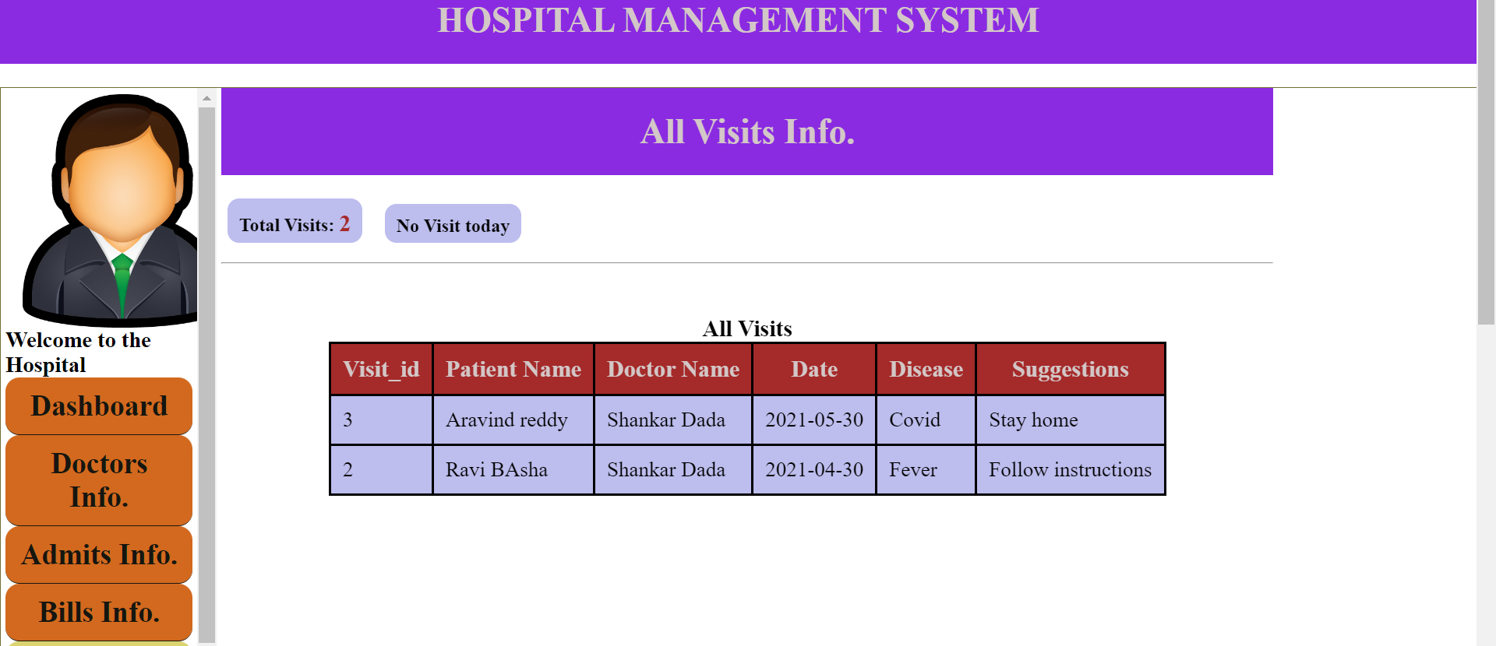
Visits info in admin portal

Slide 11
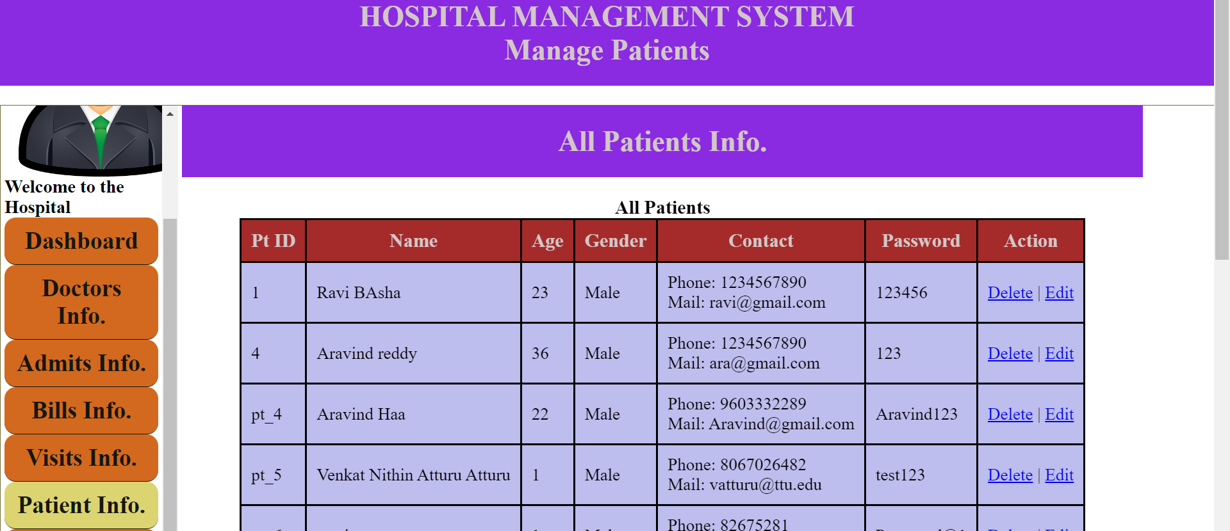
Patient info in admin portal

Slide 12
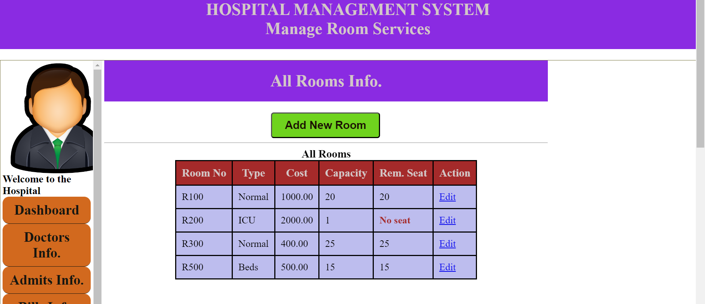
Rooms info in admin portal

Slide 13
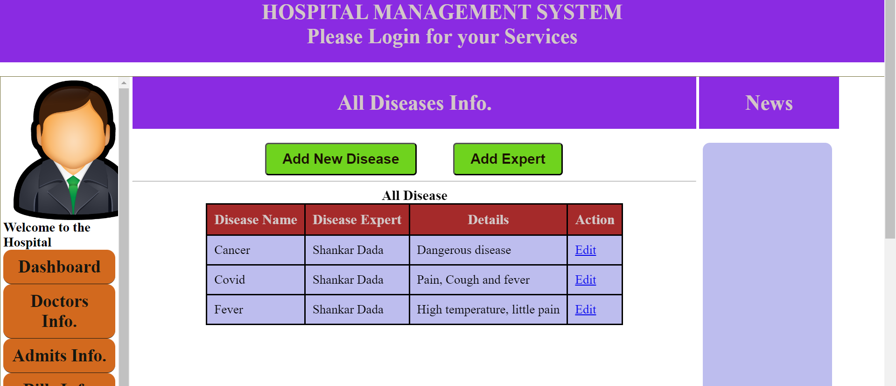
Diesease info in admin portal

Slide 14
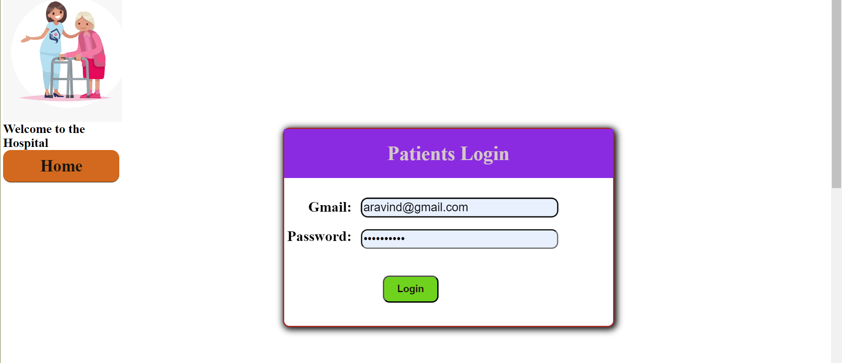
Patients login portal

Slide 15
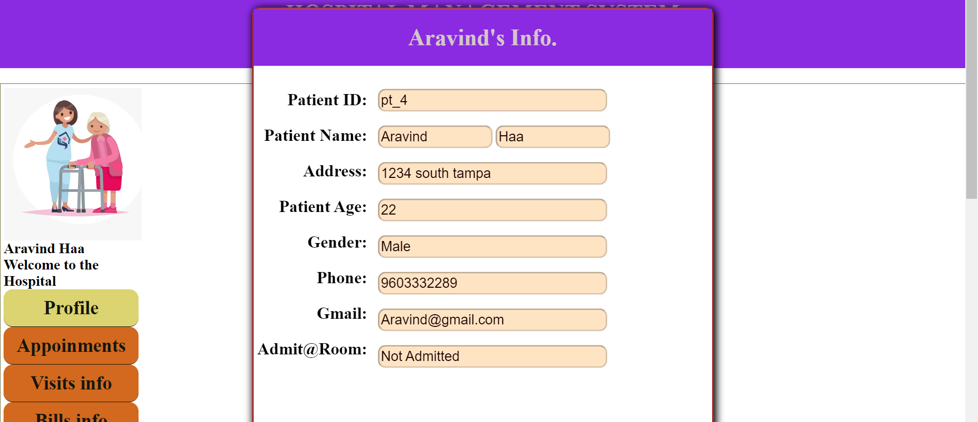
Patients profile

Slide 16
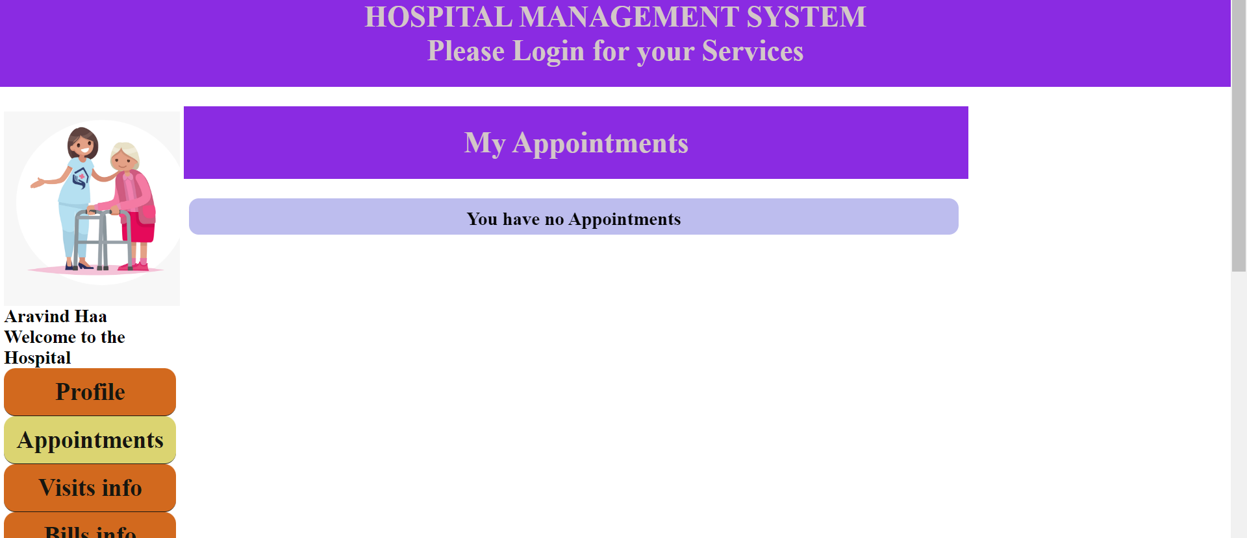
Patients Appointments

Slide 17
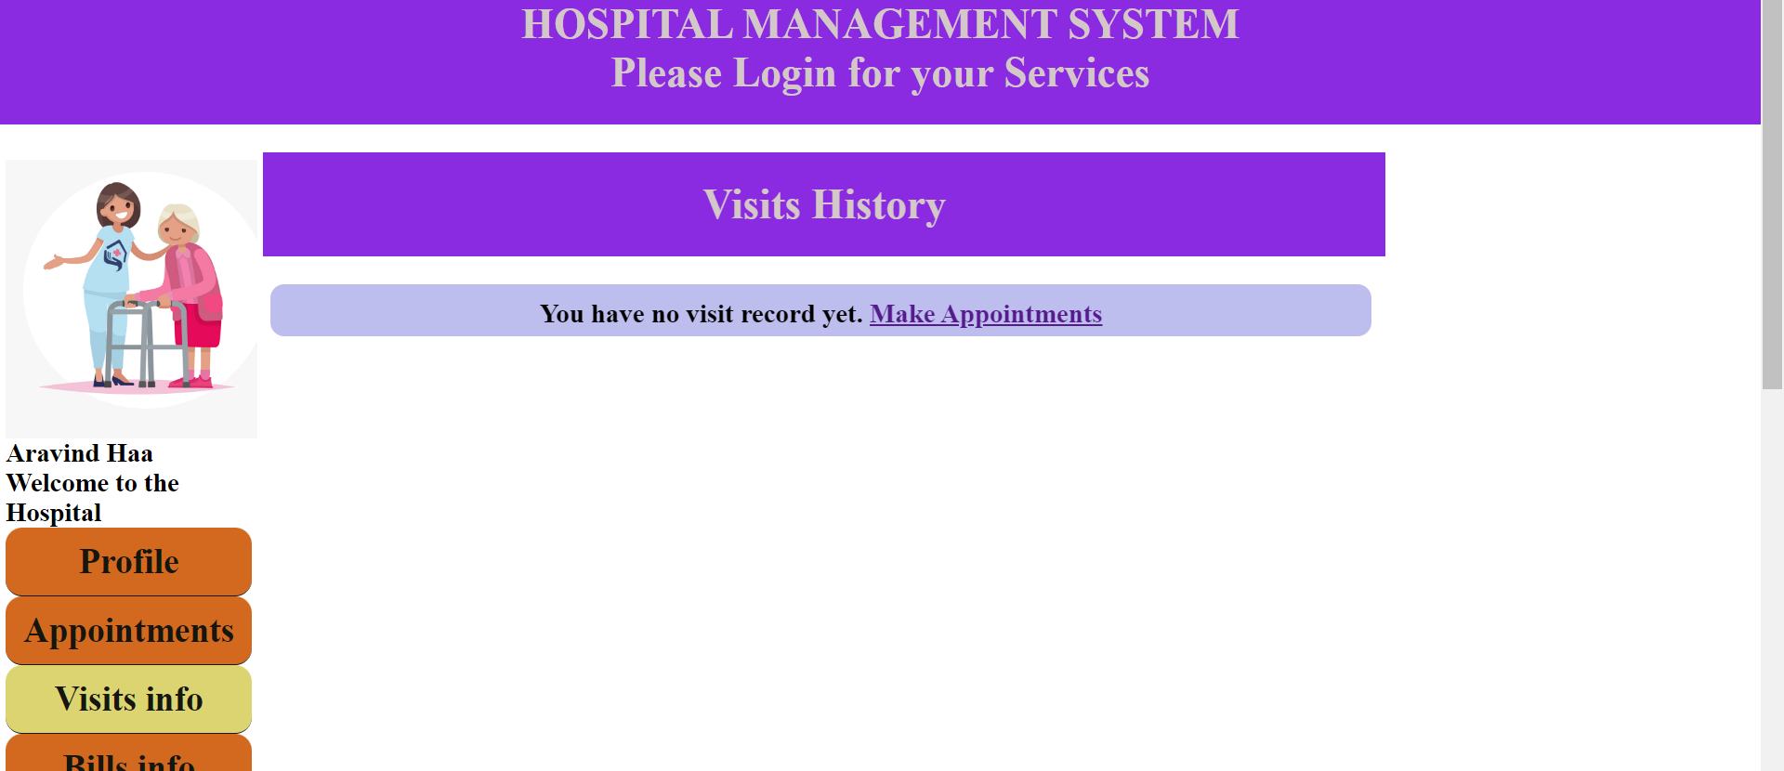
Visits info

Slide 18
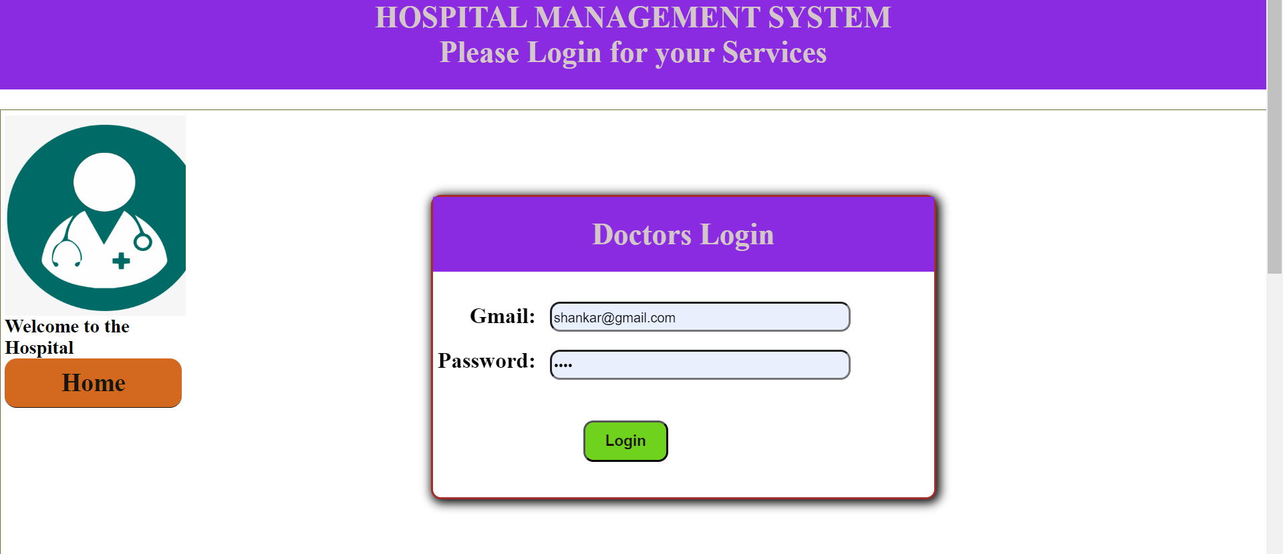
Doctors login page

Slide 19
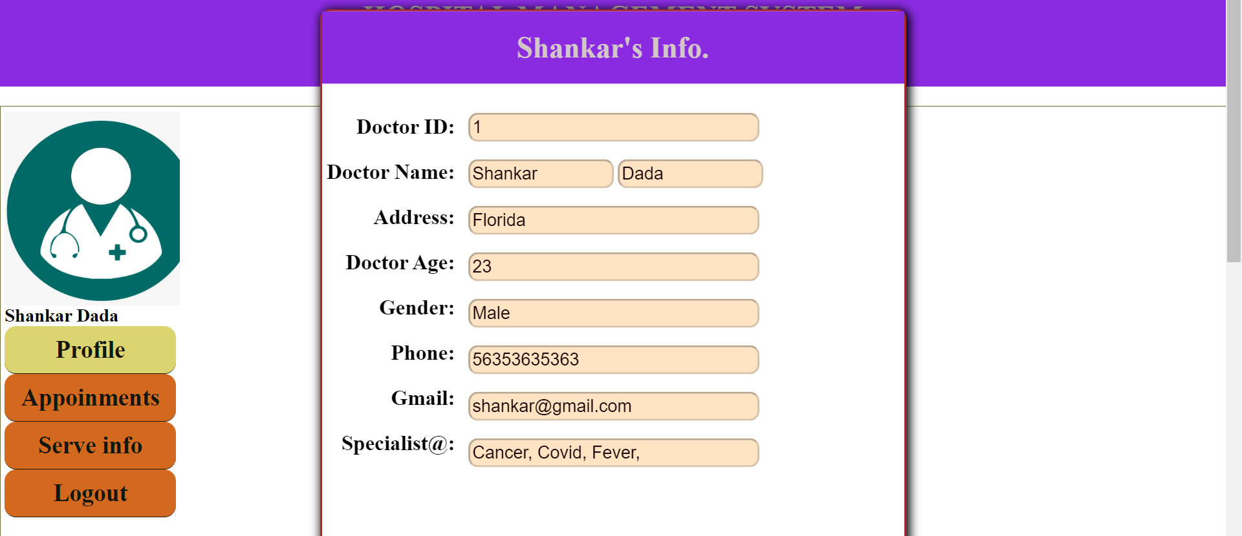
Doctors profile

Slide 20
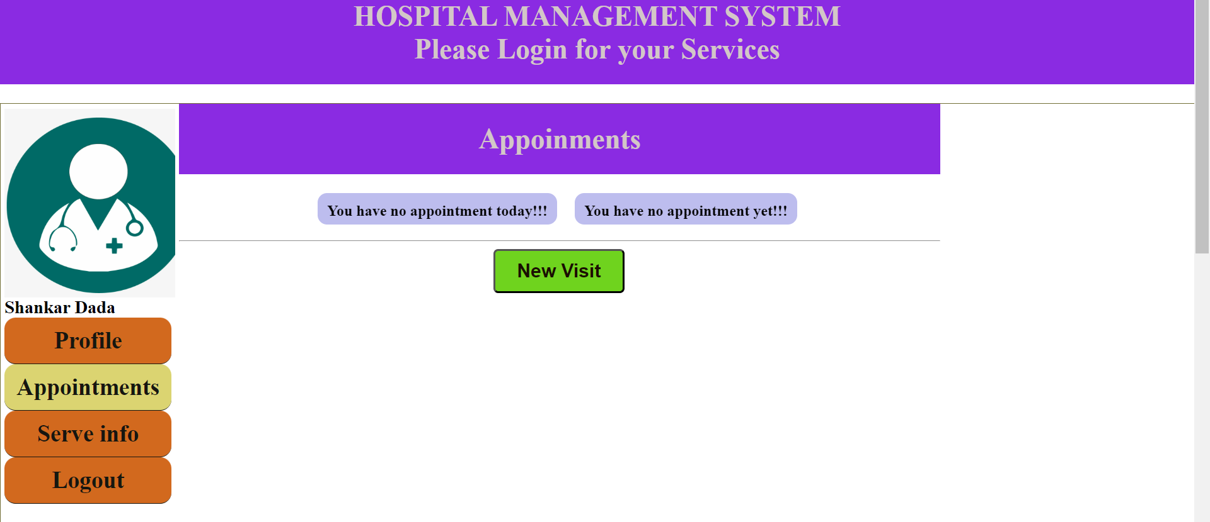
Doctors Appointments

Slide 21
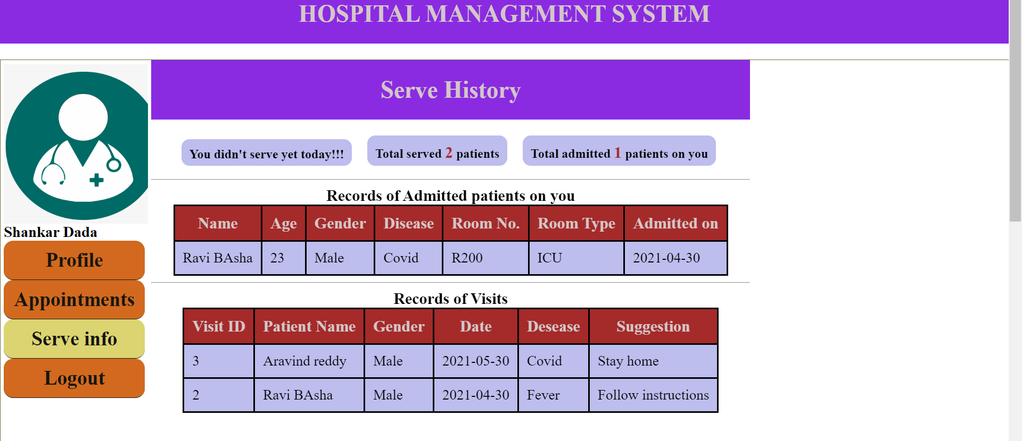
Doctors serve info

